Slide 1




Brought to you by …
P
Priti Srinivas Sajja
PS01CMCA31
Computer Fundamentals
Professor
P G Department of Computer Science,
Sardar Patel University, Gujarat, India.
PS01CMCA31
Course Content
Tutorial Practice Material
Acknowldgement References
Unit
3
Website pritisajja.info
Notes:
To view this presentation, first, turn up your volume and second, launch the self-running slide show.

Slide 2


Topics
Gates, Boolean Algebra and Truth Tables
Circuit Equivalence and De Morgan’s Theorems
Combinatorial and Arithmetic Circuits
Latches and Flip Flops
Introduction to Registers and Counters
Notes:
So there are the rules.

Slide 3

Logic Gates
Logic gates are the fundamental building blocks of digital systems.
Gate is a logic circuit with one or more inputs but only one output.
Gate is a logic circuit in which voltage levels represent logic 1 and logic 0.
A table which contains all possible alternatives of input variables and corresponding output, is called a truth table.

Slide 4
AND Gate
An AND gate has two or more input signals but only one output signal. If all inputs are high then output is high.
A B A AND B (AB)
0 0 0
0 1 0
1 0 0
1 1 1
A
A AND B
B

Slide 5
AND Gate
An AND gate has two or more input signals but only one output signal. If all inputs are high then output is high.
A B C A AND B AND C(ABC)
0 0 0 0
0 0 1 0
0 1 0 0
0 1 1 0
1 0 0 0
1 0 1 0
1 1 0 0
1 1 1 1
A
A AND B AND C
B
C

Slide 6
OR Gate
An OR gate has two or more input signals but only one output signal. If any input is high then output is high.
A B A OR B (A+B)
0 0 0
0 1 1
1 0 1
1 1 1
A
A OR B
B

Slide 7
OR Gate
An OR gate has two or more input signals but only one output signal. If any input is high then output is high.
A B C A OR B OR C(A+B+C)
0 0 0 0
0 0 1 1
0 1 0 1
0 1 1 1
1 0 0 1
1 0 1 1
1 1 0 1
1 1 1 1
A
B
C
A OR B OR C

Slide 8
NOT Gate
A NOT gate has one input signal and output signal complement to the input signal. If the input is high then output is low.
A Complement A (A)
0 1
1 0
A
A

Slide 9
NAND Gate
A NAND gate means NOT followed by AND.
A B A AND B(AB) (AB)
0 0 0 1
0 1 0 1
1 0 0 1
1 1 1 0
A
B
AB
AB
A
B

Slide 10
NAND Gate
A NAND gate means NOT followed by AND.
A B C ABC ABC
0 0 0 0 1
0 0 1 0 1
0 1 0 0 1
0 1 1 0 1
1 0 0 0 1
1 0 1 0 1
1 1 0 0 1
1 1 1 1 0
A
B
C
A
B
C
ABC
ABC

Slide 11
NOR Gate
A NOR gate means NOT followed by OR.
A B A OR B(A+B) A NOR B (A+B)
0 0 0 1
0 1 1 0
1 0 1 0
1 1 1 0
A+B
A
B
A+B
A
B
A
B
C
A
B
C
A+B+C
A+B+C

Slide 12
Bubbled Gates
A
A
A OR B
A OR B
B
B
A
A
A AND B
A AND B
B
B

Slide 13
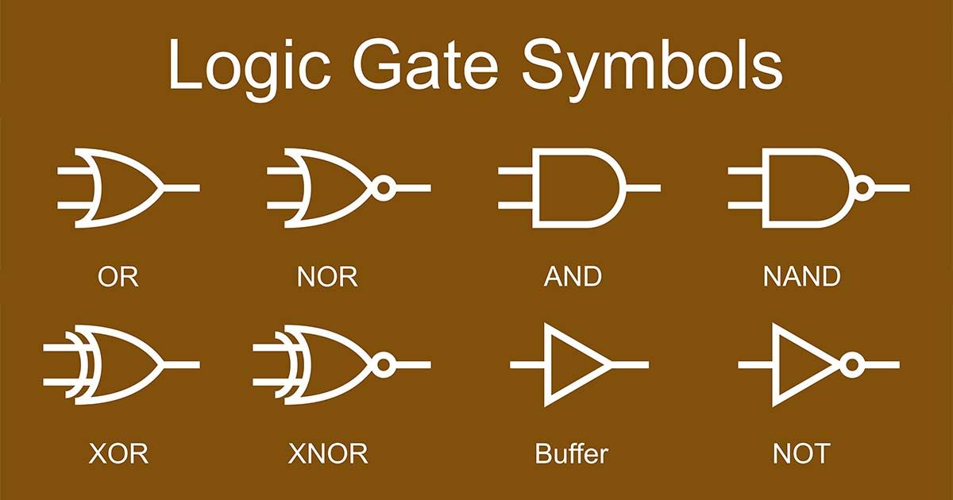
Bubbled Gates
https://www.nutsvolts.com/

Slide 14
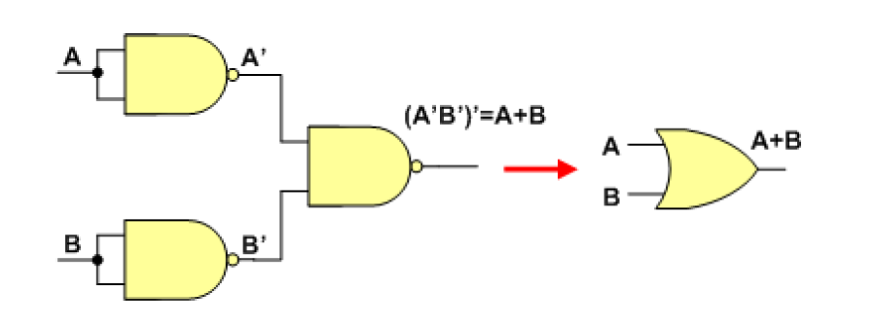
NAND Gate
AA = A
as NOT gate
A
A
AB
(AB)(AB) = AB
A
B
as AND gate
as OR gate
Universal Gate

Slide 15
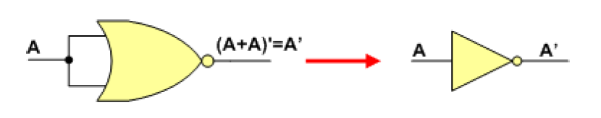
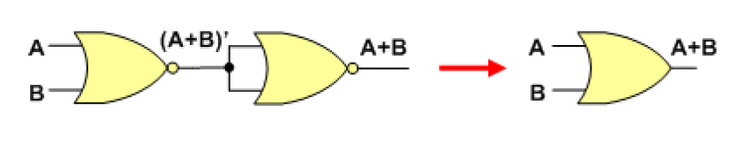
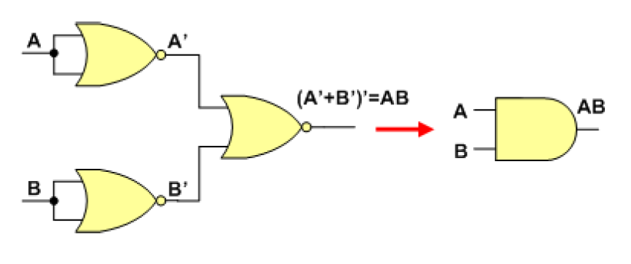
NOR Gate
as Not gate
as OR gate
as AND gate
http://faculty.kfupm.edu.sa/COE/abouh/Lesson2_6.pdf

Slide 16
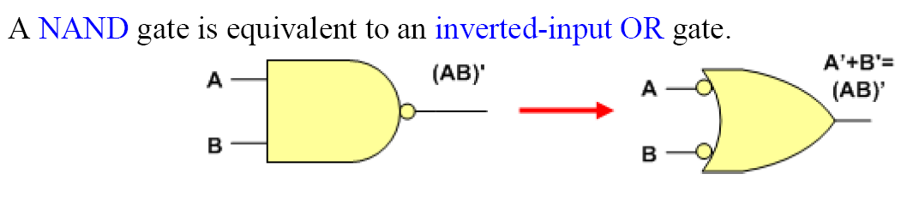
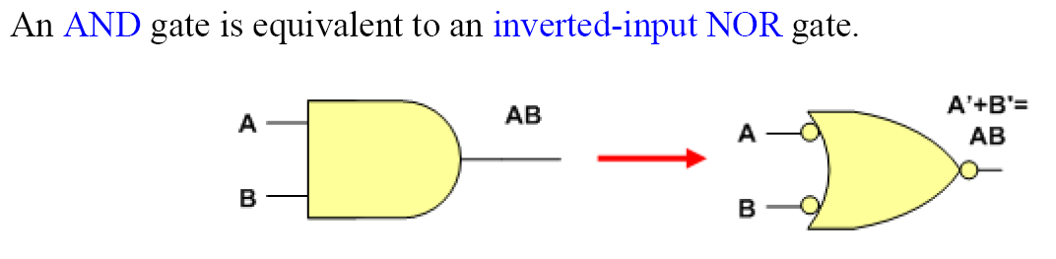
Equivalent Gate/Circuits
http://faculty.kfupm.edu.sa/COE/abouh/Lesson2_6.pdf

Slide 17
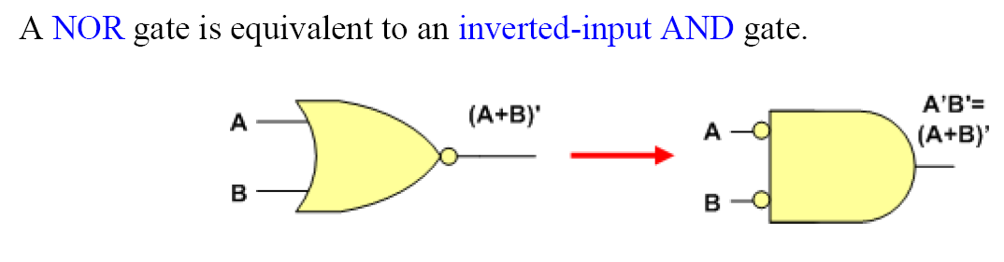
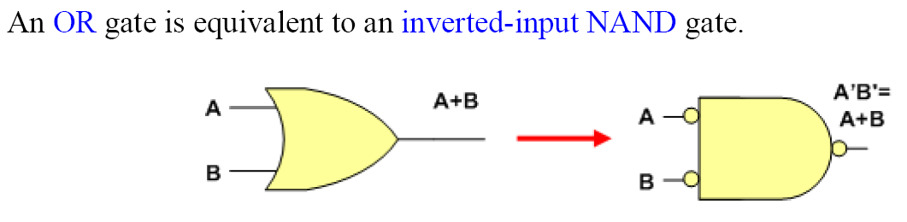
Equivalent Gate/Circuits
http://faculty.kfupm.edu.sa/COE/abouh/Lesson2_6.pdf

Slide 18
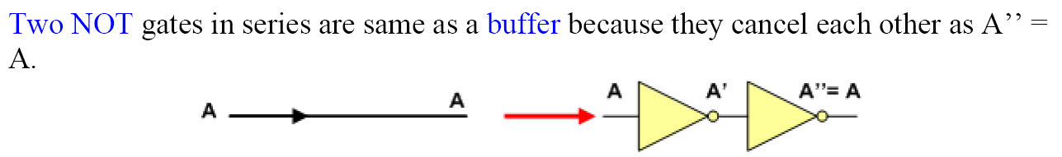
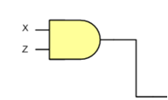
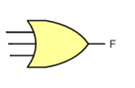


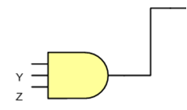

Equivalent Gate/Circuits
Implement F = XZ + Y’Z + X’YZ
http://faculty.kfupm.edu.sa/COE/abouh/Lesson2_6.pdf

Slide 19
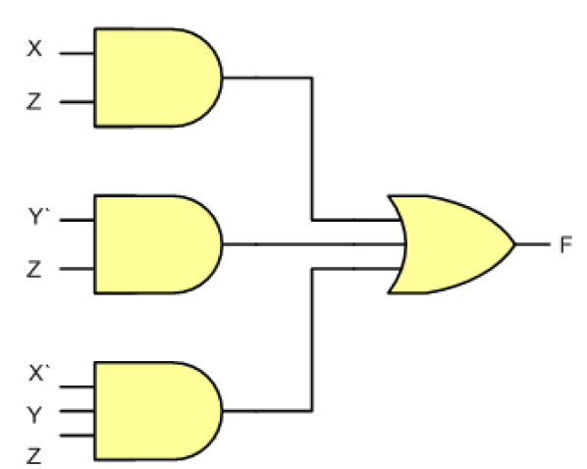
Equivalent Gate/Circuits
Implement F = XZ + Y’Z + X’YZ
http://faculty.kfupm.edu.sa/COE/abouh/Lesson2_6.pdf

Slide 20
Decimal to Binary encoder
0
1
2
3
4
5
6
7
8
9
0000
0001
0010
0011
0100
0101
0110
0111
1000
1001
OR
OR
OR
OR

Slide 21
Block/Transmit 6 bit word
6 bit Register
A B C D E F
Enable 0/1
Y₅ Y₄ Y₃ Y₂ Y₁ Y₀

Slide 22
Block/Transmit 6 bit word
6 bit Register
1 1 0 0 0 1
Enable = 0
Y₅ Y₄ Y₃ Y₂ Y₁ Y₀

Slide 23
Block/Transmit 6 bit word
6 bit Register
1 1 0 0 0 1
Enable=1
Y₅ Y₄ Y₃ Y₂ Y₁ Y₀

Slide 24

1 of 10 decoder
4 bits Register
A B C D
Y₀
0000
0001
0010
0011
0100
0101
0110
0111
1000
1001
Y₁
Y₂
Y₃
Complete this…up to Y₉
Y₄
Y₅
Y₆
Y₇
Y₈
Y₉

Slide 25
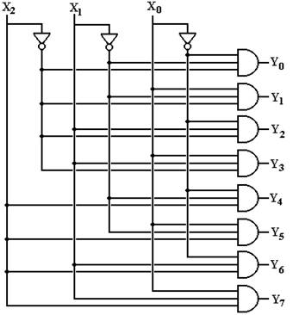
3 to 8 decoder
A B C

Slide 26
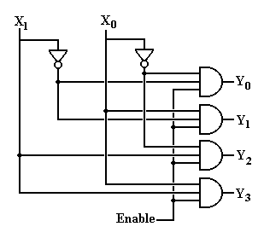
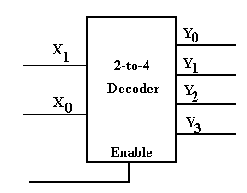
2 to 4 decoder

Slide 27
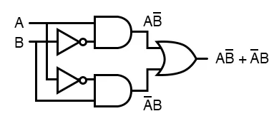
XOR Gate
A B A B A B A XOR B(A ⊕ B) =
0 0 0 0 0
0 1 1 0 1
1 0 0 1 1
1 1 0 0 0
A B + A B
A
A XOR B
B
A XNOR B
XOR Gate Symbol
XOR Circuit
A
A XNOR B
XNOR Gate Symbol
B

Slide 28
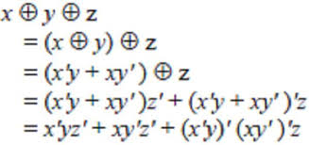
XOR Gate
A ⊕ B ⊕ C = A B C + A B C + A B C + A B C
Draw logic circuit and truth table for the same.
If number of 1’s are odd what will be the output?
A
B
A XOR B XOR C
C

Slide 29
XOR Gate
A ⊕ B ⊕ C = A B C + A B C + A B C + A B C
A | B | C | A ⊕ B ⊕ C
0 | 0 | 0 | 0
0 | 0 | 1 | 1
0 | 1 | 0 | 1
0 | 1 | 1 | 0
1 | 0 | 0 | 1
1 | 0 | 1 | 0
1 | 1 | 0 | 0
1 | 1 | 1 | 1

Slide 30
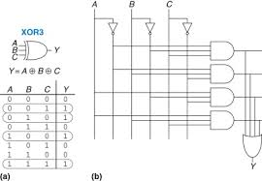
XOR Gate
A ⊕ B ⊕ C = A B C + A B C + A B C + A B C

Slide 31
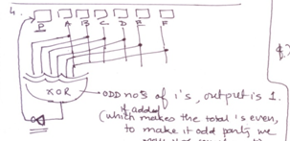
XOR Gate Applications
odd parity generator for a six bit word
Can you draw odd parity tester for six bit word?

Slide 32
Boolean Algebra
De Morgan’s Theorem 1
A+B= A B
Prove with help of truth table and draw logic circuits fro LHS and RHS.
This can be extended for any number of variable eg.
A+B+C+D = A B C D
A+BC+DEF = A BC DEF

Slide 33
Boolean Algebra
De Morgan’s Theorem 1
A+B= A B
A | B | A+B | A+B
0 | 0 | 0 | 1
0 | 1 | 1 | 0
1 | 0 | 1 | 0
1 | 1 | 1 | 0
A | B | A | B | A B
0 | 0 | 1 | 1 | 1
0 | 1 | 1 | 0 | 0
1 | 0 | 0 | 1 | 0
1 | 1 | 0 | 0 | 0
A
A
A + B
A B
B
A + B
B

Slide 34
Boolean Algebra
De Morgan’s Theorem 2
AB = A + B
Homework: Prove with help of truth table and draw logic circuits fro LHS and RHS.
This can be extended for any number of variable eg.
A B C D = A + B + C + D
(A) (BC) (DEF) = (A) + (BC) + (DEF)

Slide 35
Expressions …
Boolean Relations
Commutative Law:
A+B=B+A
AB=BA
Associative Law:
A+ (B+C) = (A+B) +C
A (BC) = (AB)C
Distributive Law:
A(B+C)=AB+AC

Slide 36
Expressions …
Boolean Relations
A+0=A
A+A=A
A+1=1
A+A=1
A0=0
AA=A
A1=A
AA=0
A = A

Slide 37
Expressions …
Prove that A+BC=(A+B)(A+C)
RHS=
(A+B)(A+C)
AA +AC+BA+BC
A +AC+AB + BC
A(1+C+B) + BC (adding 1 into anything is 1)
A(1) + BC
A+BC
=LHS

Slide 38
Expressions …
Prove that A(B+C)=AB+AC with help of truth table
A | B | C | B+C | A(B+C) | AB | AC | AB+AC
0 | 0 | 0 | 0 | 0 | 0 | 0 | 0
0 | 0 | 1 | 1 | 0 | 0 | 0 | 0
0 | 1 | 0 | 1 | 0 | 0 | 0 | 0
0 | 1 | 1 | 1 | 0 | 0 | 0 | 0
1 | 0 | 0 | 0 | 0 | 0 | 0 | 0
1 | 0 | 1 | 1 | 1 | 0 | 1 | 1
1 | 1 | 0 | 1 | 1 | 1 | 0 | 1
1 | 1 | 1 | 1 | 1 | 1 | 1 | 1

Slide 39
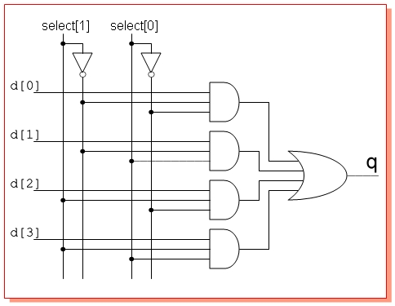
Multiplexer
Means many into one , also called data selector
4 to 1 multiplexer circuit
http://electrosofts.com/verilog/mux.html

Slide 40
Multiplexer
Means many into one , also called data selector
4 to 1 multiplexer circuit
Add two more select here for 16 to 1 multiplexing

Slide 41
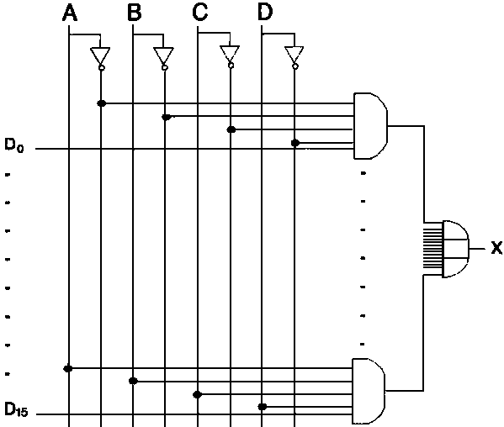
Multiplexer
16 to 1 multiplexer circuit

Slide 42

Word Comparator
Word Comparator
If word size is 4 then it is also
known as nibble comparator.
Register having word A
Register having word B

Slide 43
Nibble Multiplexer
L1 L2 L3 L4
R1 R2 R3 R4
R
AND
AND
AND
AND
AND
AND
AND
AND
Not
OR
OR
OR
OR
OUT

Slide 44
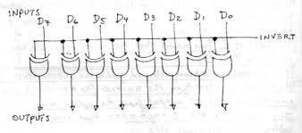
Control Inverter

Slide 45
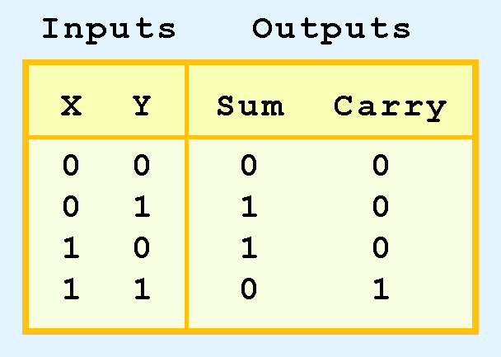
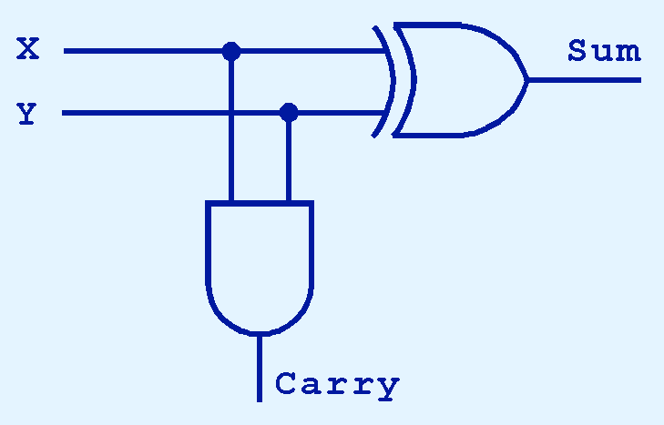
Combinational and Arithmetic Circuits
As we see, the sum can be found using the XOR operation and the carry using the AND operation.

Slide 46
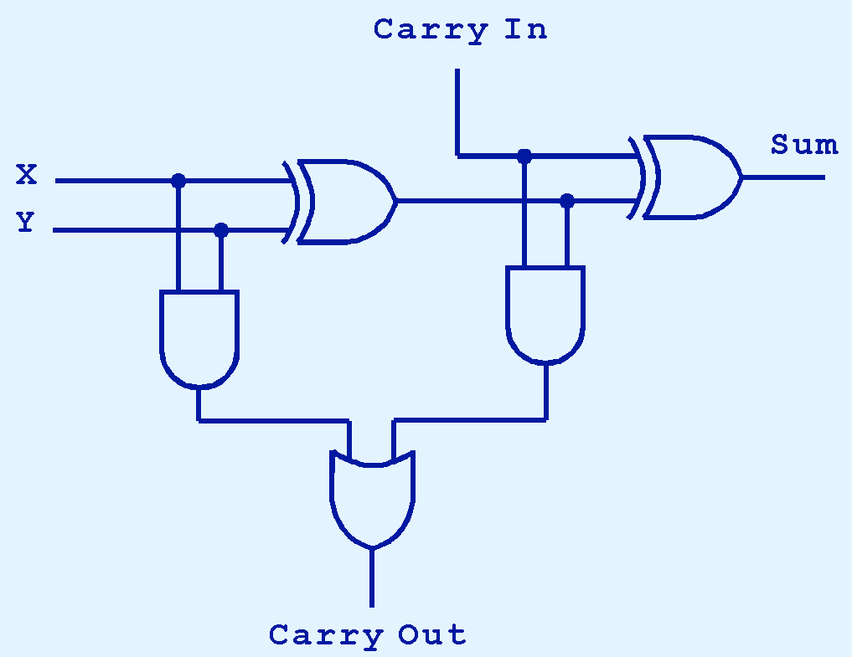
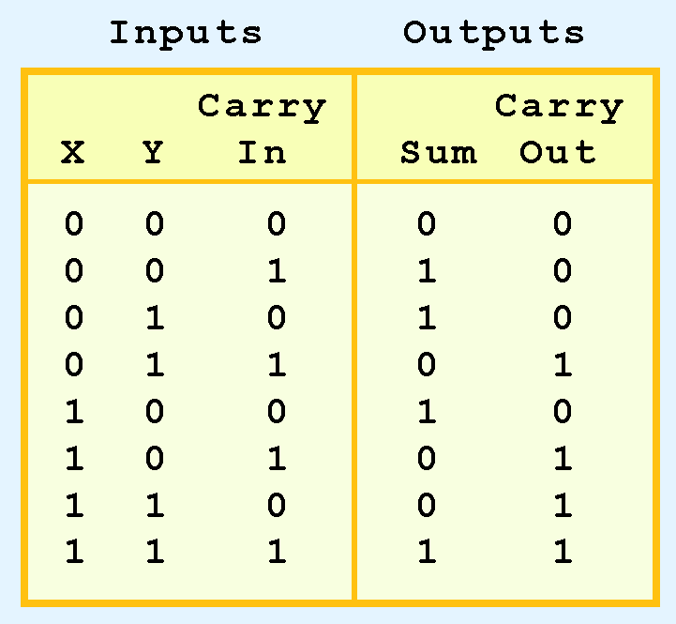
Combinational and Arithmetic Circuits
The completed full adder is as follows.

Slide 47
Binary Adder
A₃ B₃
A₂ B₂
A₁ B₁
A₀ B₀
C₄
FA
C₃
FA
C₂
FA
C₁
HA
S₃
S₂
S₁
S₀

Slide 48
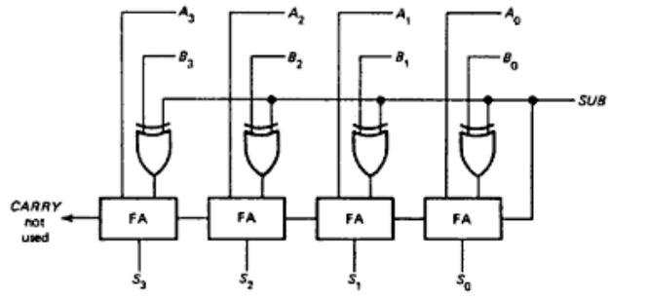
2’s complement adder subtractor
Try with A=1001 and B=0010.

Slide 49
Latches and Flip-flops
A flip-flop is a device that with two stable states, it remains in one till it is triggered to the other. It is also known as SR latch (set-reset). It remembers a bit.
R | S | Q | Comments
0 | 0 | NC | No change
0 | 1 | 1 | Set
1 | 0 | 0 | Reset
1 | 1 | * | Race

Slide 50
Latches and Flip-flops
R | S | Q | Comments
0 | 0 | NC | NC
0 | 1 | 1 | Set
1 | 0 | 0 | Reset
1 | 1 | * | Race
SR latch
The most fundamental
latch where S and R stand for set and reset.
It can be constructed from a pair of cross-coupled NOR or Nand logic gates.
The latch has two useful states. When output Q = 1 and Q’ = 0, the latch is said to be in the set state.
When Q = 0 and Q’ = 1, it is in the reset state .
Outputs Q and Q are normally the complement of each other.
However, when both inputs are equal to 1 at the same time, a condition in which both outputs are equal to 0 (rather than be mutually complementary) occurs.
If both inputs are switched to 0 simultaneously, the device will enter an unpredictable or undefined state or a metastable state.
So in practical applications, setting both inputs to 1 is forbidden.
The stored bit is present on the output marked Q.
Under normal conditions, both inputs of the latch remain at 0 unless the state has to be changed.

Slide 51
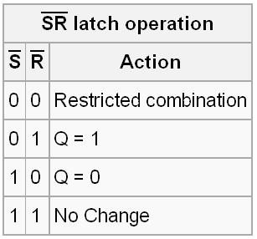
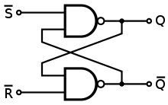
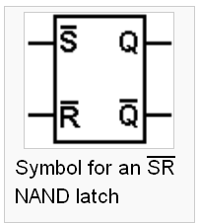
Latches and Flip-flops
This is an alternate model of the simple SR latch which is built with NAND (not AND) logic gates.

Slide 52
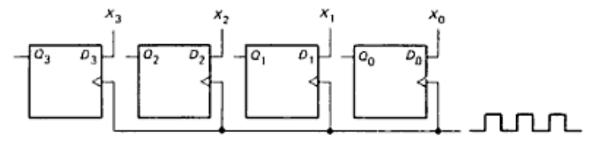
Registers
Buffer Register

Slide 53
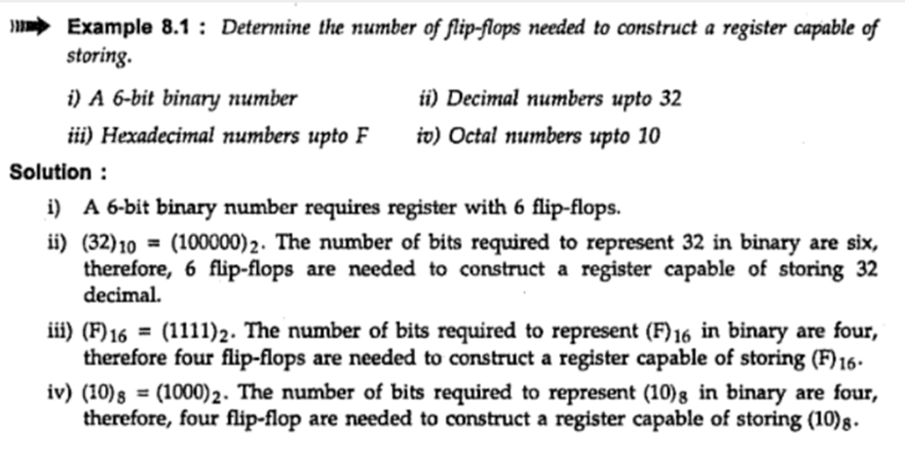
Registers

Slide 54
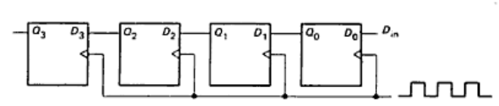
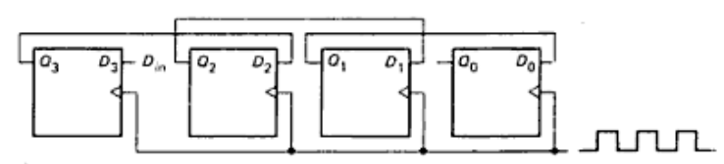
Registers
Shift Left and Shift Right Registers
Simple buffer register

Slide 55
Counters
A counter is a sequential circuit that goes through a predetermined sequence of states upon the application of clock pulses.
Counters are categorized as:
Synchronous Counter: All Flip-flops (FF) receive the common clock pulse, and the change of state is determined from the present state.
Ripple Counters: The FF output transition serves as a source for triggering other FFs. No common clock.

Slide 56
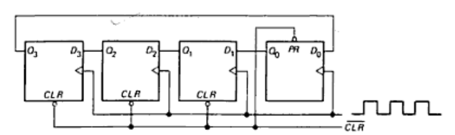
Counters
Ring Counter
Ring counter is build with D flip flops, where each word is having only one high bit.
It resembles a shift left register.
When CLR goes low then back to high, the initial output word is Q=0001
The first positive clock edge shifts the most significant bit(MSB) into the Last Significant position, and the output word becomes Q=0010
The second positive clock edge causes another rotate left and output is Q=0100
After third positive clock edge Q=1000 and
After forth positive clock edge Q=0001
To activate one of the several devices, or sequence of operation, ring counter is used.

Slide 57

Acknowledgement
“Intelligent technologies for web applications”, CRC Press (Taylor & Francis Group), Boka Raton, FL, USA (2012)
AP Godse and DA Godse, Digital principles and systems design, Technical publications, Pune
clker.com
http://electrosofts.com/verilog/mux.html
http://www.briarcliff.edu/departments/cis/CSCI280/Index-2010c.htm
Malvino A. P.: Digital Computer Electronics,2nd Edition, Tata McGraw, Hill Pub. Co. Ltd.,New Delhi, 1990.
nzdl.org

